Slide 1
Speech Recognition using Matlab

Slide 2
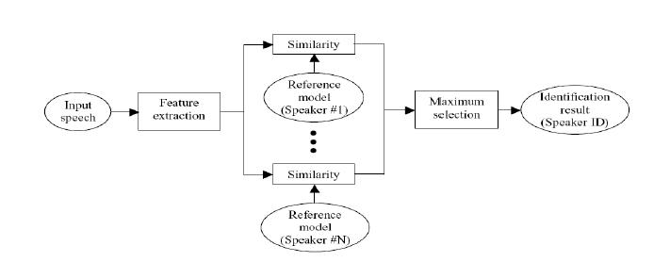
Speaker Identification Training

Slide 3
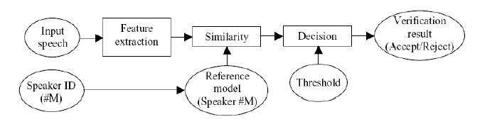
Speaker Identification Testing

Slide 4
Algorithms
Feature Extraction:
Mel Frequency Ceptrum Coefficient (MFCC).
Feature Matching:
Vector Quantization (VQ).

Slide 5
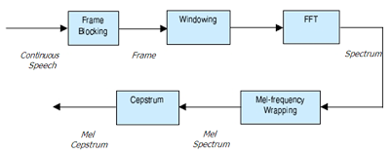
Block diagram of the MFCC
Mel (f) = 2595 * log10 (1 + f/700)

Slide 6
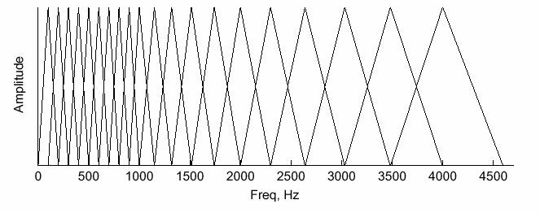
Mel Frequency filter bank

Slide 7
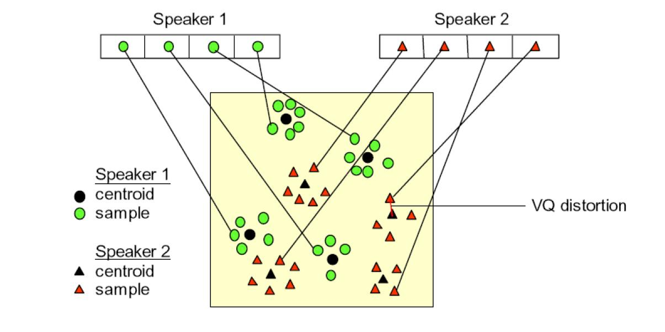
Vector Quantization

